Slide 1

Intelligent Placement and Career Development Platform
by
PAVAN KUMAR A
Roll No. 214G1A3272
NEERAJA V
Roll No. 214G1A3267
VIJAYA DURGA C
Roll No. 214G1A32C1
VASIM SUBAHANI S
Roll No. 214G1A32B7
Under the guidance of
Mr. K. Venkatesh _{M. Tech., (Ph. D)}
Assistant Professor
Department of Computer Science and Engineering (Data Science)
Srinivasa Ramanujan Institute of Technology (Autonomous)
(Affiliated to JNTUA & Approved by AICTE) (Accredited by NAAC with ‘A’ Grade & Accredited by NBA (EEE, ECE & CSE)
Rotarypuram Village, B K Samudram Mandal, Ananthapuramu – 515701.
2024 - 2025

Slide 2
Review 0 Queries
Review 0 Queries:
How to get CGPA of a student who is having 1 or 2 backlogs?
Gathering all SGPAs from each semester, including those with backlogs. Even with backlogs, the CGPA calculation is based on all semester’s SGPA and credits by using the below formula
CGPA = ∑(SGPA of each semester × Credits of that semester)​
∑(Credits of all semesters)
Is it necessary to use NLP in your project?
NLP helps in extracting and analyzing relevant information from resumes, such as skills, experience, qualifications, and keywords. Sentiment analysis is a key NLP technique that helps determine the positive, negative, or neutral sentiment behind text data, such as user reviews or feedback.

Slide 3
Abstract
Colleges have to simplify their training and placement procedures due to the growth of institutions of higher learning and increased competition in the job market. Inefficient practices including manual student filtering, challenging data maintenance and lack of immediate interaction between students, professors and the Training and Placement Officer (TPO). Monitoring training progress, coordinating firm recruitment drives, tracking student eligibility and offering customized interview preparation materials are significant issues for educational institutions. Institutions suffer from unstructured resume screening, ineffective preparation for interviews and the inability to produce insights regarding student development. To overcome these challenges, we suggest a thorough, AI-powered Training and Placement Management System (TPMS) that is constructed with Django. It incorporates dashboards for teachers, students and TPOs to automate and quicken the placement process. By incorporating AI-based analytics and automation into training and recruitment processes this entire platform dramatically lowers manual load, increases placement efficiency and improves student employability.
Keywords: Academic Year, Eligibility, Faculty, Placement, Student, Training and User Management.

Slide 4

Contents
Abstract
Problem Statement
Objectives of Project
Literature Survey for first objective
Literature Survey for second objective
Introduction
Existing System
Proposed System
4

Slide 5
Cont’d…
Planning
Requirements
Modules
UML Diagrams
Data Flow Diagram
Data Preprocessing Techniques
References
GitHub Link
5

Slide 6
Problem Statement
The existing placement process in educational institutions faces several challenges that hinder efficiency and effectiveness.
Manual tasks in the placement process increase the workload for administrators and lead to errors in data handling and management.
Lack of centralized and secure data storage for student credentials, company profiles, and job postings creates inconsistencies and delays.
Absence of an automated system for notifying students about job opportunities and managing the recruitment timeline results in communication gaps.
Limited avenues for students to share their placement experiences and access peer insights reduce collective learning opportunities.
6

Slide 7
Objectives of Project
Automate Placement Management – Streamline the placement process by providing a centralized system for tracking student progress, managing placement records, and organizing recruitment activities.
Enhance Student Career Readiness – Improve student employability by offering NLP-based resume evaluation, personalized training recommendations, and real-time placement updates.
Support the Training & Placement Officer (TPO) – Provide a dashboard for the TPO to monitor student training progress, placement statistics, and recruitment activities efficiently.
7

Slide 8
Introduction
The increasing competition in the job market has highlighted the importance of equipping students with the skills and knowledge required to meet the expectations of recruiters and excel in placement processes.
Educational institutions often face challenges in effectively managing placement statistics, monitoring student progress and providing tailored resources to enhance career readiness.
Traditional approaches to career development and placement management are limited in their ability to provide actionable insights, personalized recommendations and efficient support for both students and recruiters.
Students frequently encounter difficulties in aligning their resumes and skillsets with the requirements of hiring companies, while recruiters struggle to identify suitable candidates efficiently.

Slide 9
Literature Survey
No | Title | Author | Journal Name & Year | Methodology Adapted | Key Findings | Gaps
1 | Smart Preparation Web Application for Placements Using Machine Learning | Prasanna Kandekar, Manjiri Raut | International Research Journal of Engineering and Technology (IRJET) & 2024 | Uses AI/ML models, and Node.js with MongoDB for data and feedback. | Helps students prepare better with accurate predictions and tailored learning. | Needs improved privacy, personalization, and testing.
2 | Enhancing Student Placement with Cross-Platform Application | Anand Kale, Shreyas Joshi et al. | International Journal for Research in Applied Science & Engineering Technology & 2024 | React Native and Spring Boot for backend | Efficient data management, document verification, and modular user roles | Limited focus on AI-enhanced analytics and scalability for large datasets
3 | C3-IoC: A Career Guidance System for Assessing Student Skills using Machine Learning and Network Visualisation | Adán José-García, Alison Sneyd et al. | International Journal of Artificial Intelligence in Education & 2024 | AI-based solution with similarity metrics and skill profiling | Career guidance through job role matching and visual networks | Limited adaptation to non-IT sectors and dynamic market trends

Slide 10
Cont’d…
No | Title | Author | Journal Name & Year | Methodology Adapted | Key Findings | Gaps
4 | Enhancing Student Placement Preparation Through Web Application | P Shanmugam, Janhavi Lenka et al. | International Conference on Innovative Computing & Communication & 2024 | Comprehensive platform with personalized learning and mentorship. | Tailored resources, student progress tracking, and collaboration among stakeholders. | Lack of AI-driven analytics and industry-specific real-time recommendations.
5 | An Integrated Web Application for Training and Placement | Dr. Gauri Dhopavkar et al. | Mathematical Statistician and Engineering Applications & 2022 | Development of a Training & Placement Portal System using automation. | Automated tasks improve precision, save time, and provide students with notifications, question banks, and company details. | Lack of advanced analytics for personalized student-company matching and integration of AI.
6 | Design and Development of Department Placement Portal using MERN Technology | Fiza Kousar et al. | International Advanced Research Journal in Science, Engineering and Technology & 2022 | MVC architecture using MERN stack for web portal development. | Simplifies placement tasks with modules for student credentials, job postings, and placement statistics. | Limited focus on advanced analytics or AI for enhancing student-company matching efficiency.

Slide 11
Existing System
All processes in existing system are handled manually. All the work that is done in the existing system is done by the human intervention .As all the work is done manually, there were a lot of workload on placement officer and it also increases the maximum chances of errors.
This is so slow and time consuming. Due to increase in number of user’s the process become more difficult. Problems faced in existing system are as follows
Searching of eligible students is done manually by TPO based on the company criteria.
The records were stored in modified excel sheets hence sorting problem.

Slide 12
Cont’d…
The duplication of records was usual hence data redundancy.
TPO’s have to collect all the information and Resumes of students and organize them manually and sort them according to various streams.
Collecting CV’s of so many student is a painful and time consuming task and handling of too many CV’s is a great overhead.
It takes too much time to managing, updating and informing specific student for specific company criteria.

Slide 13
Drawbacks
Placement officers must manually handle tasks like collecting student eligibility, tracking applications, and verifying data, making the process time-consuming and prone to errors.
The system relies on manually updated records, leading to outdated or incorrect data, which affects recruitment decisions.
Placement officer do not have detailed metrics or insights about student performance, skills, or progress, making shortlisting inefficient.
Students lack a system to customize or generate resumes tailored to recruiter-specific eligibility criteria, which decreases their chances of selection.
The system lacks tools to provide students with personalized training or recommendations for skill improvement.
The existing system is not user-friendly, with a complex interface and limited accessibility features, discouraging effective use.

Slide 14
Proposed System
Placement Statistics Management: The system provides real-time insights into placement statistics, including the number of students placed, job roles and company-wise data.
Student Performance Tracking: A performance tracking module monitors students' progress in training programs, offering detailed feedback and analytics to help students identify areas for improvement.
AI-Driven Resume Scanning: Utilizing NLP and AI techniques, the system evaluates resumes, assigns scores based on relevance and quality, and suggests improvements to align with industry requirements.
Recruitment Process Information: The platform provides a comprehensive database of company profiles and recruitment processes, helping students understand the expectations of recruiters.
Personalized Learning Recommendations: A recommendation engine powered by sentiment analysis and machine learning suggests training videos and resources tailored to individual students' learning styles.

Slide 15
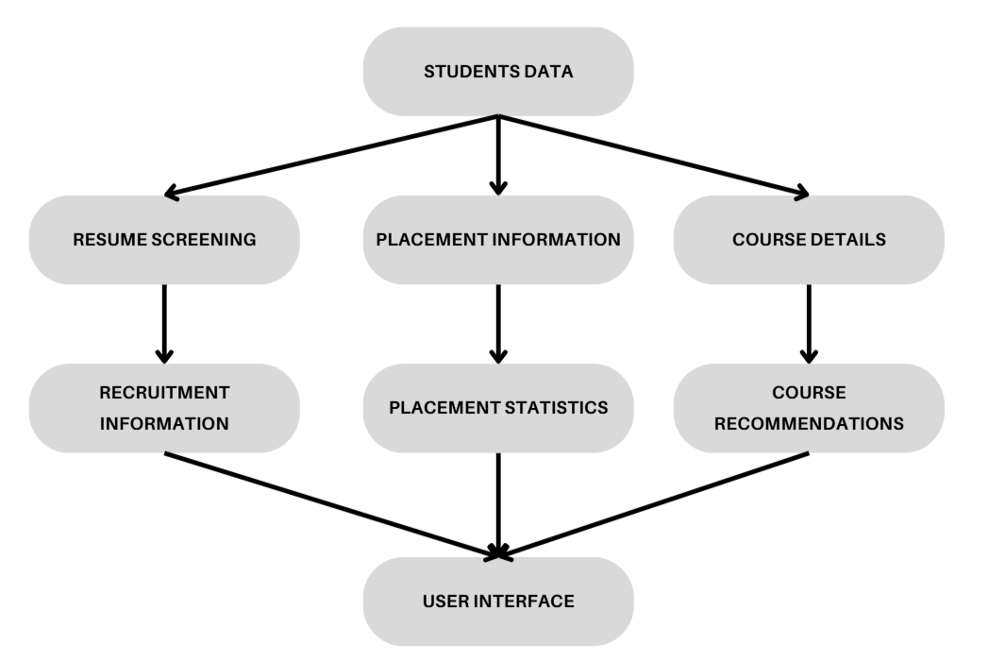
Planning
15

Slide 16
Requirements : Functional Requirements
AI-Driven Resume Scanner
Placement Process Tracking
Company Profile Management
Training Program Tracking and Feedback
Personalized Training Video Recommendations
16

Slide 17
Requirements : Non-Functional Requirements
Scalability
System Performance and Speed
User Interface Usability
Data Integrity
Cross-Platform Compatibility
Reliability and Availability
System Maintainability and Security
17

Slide 18
Modules
AI-Driven Resume Scanner: Analyzes student resumes, scores them, and provides suggestions for improvement based on recruiter requirements.
Company Profile Management: Administers the addition and updating of company profiles, including job descriptions and eligibility criteria.
Training Program Tracking: Monitors student participation and performance in training programs, offering feedback to enhance skill development.
Sentiment-Based Recommendation Engine: Uses sentiment analysis to recommend personalized learning resources like training videos based on students' emotional responses.
Placement Process Tracker: Tracks ongoing and past placement processes, providing status updates and notifications to students.
18

Slide 19
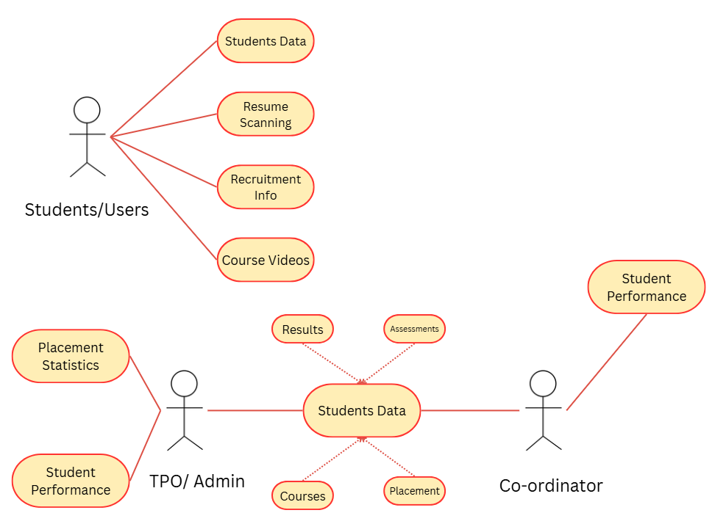
UML Diagrams – Use Case Diagram

Slide 20
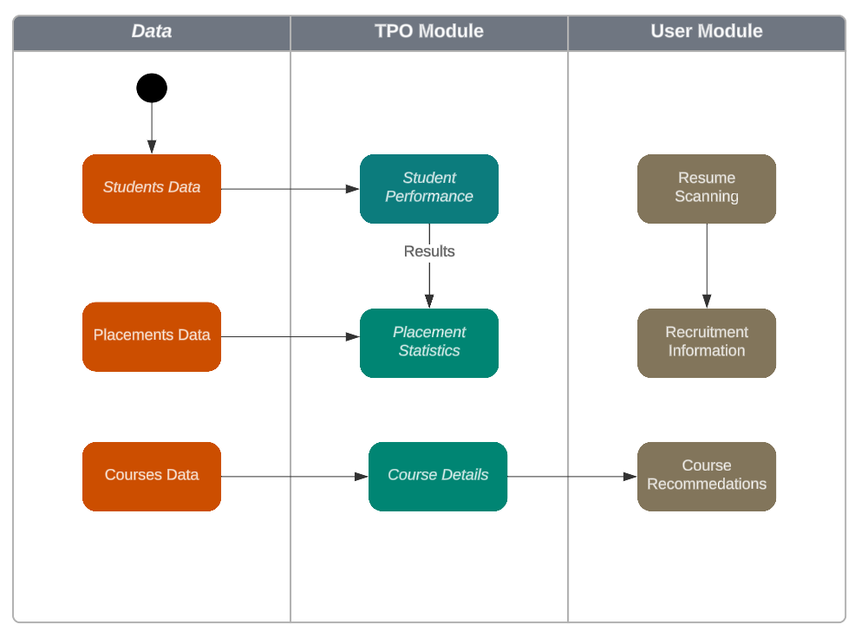
UML Diagrams- Activity Diagram
20

Slide 21
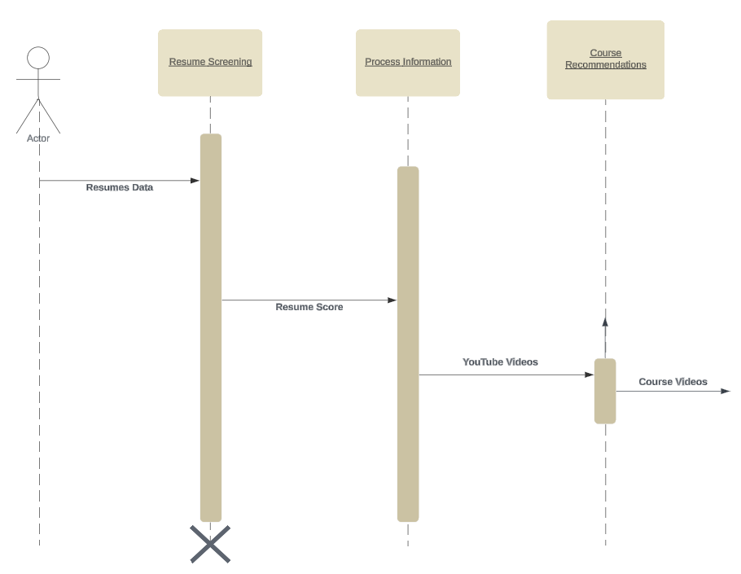
UML Diagrams- Sequence Diagram
21

Slide 22
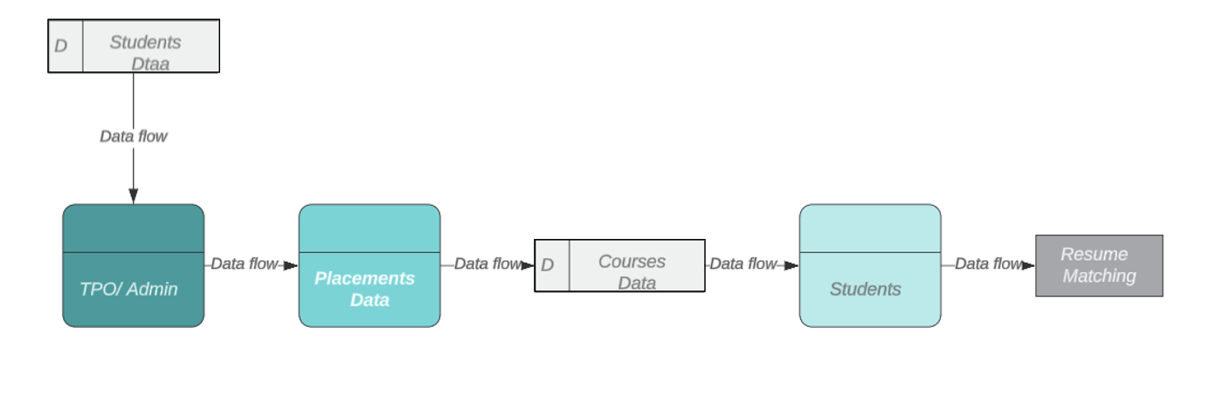
Data Flow Diagram
Student Placement Data Flow Diagram

Slide 23
Data Preprocessing Techniques
Data Cleaning:
Description: Removes or corrects inconsistent, incomplete or irrelevant data from the dataset.
Technique Used: Handling missing values (either by removing or filling with statistical measures such as mean or median), correcting data types (e.g., converting numerical data stored as text), and eliminating duplicate entries.
Data Normalization/Standardization:
Description: Scales the data to ensure it is in a similar range, helping algorithms perform better.
Technique Used: Min-Max normalization to scale features between a range of 0 and 1 or Z-score standardization to bring the data into a standard normal distribution (mean = 0, standard deviation = 1).
23

Slide 24
Cont’d…
Text Preprocessing:
Description: Cleans and prepares text data for Natural Language Processing (NLP) tasks, such as resume analysis or job description processing.
Technique Used:
Tokenization: Splitting text into words or phrases.
Stop word removal: Eliminating common words (e.g., "and", "the") that do not contribute meaningful information.
Lemmatization: Reducing words to their root form (e.g., "running" becomes "run").
Stemming: Reducing words to their base form (e.g., "fishing" becomes "fish").
24

Slide 25
Cont’d…
Feature Selection:
Description: Identifies the most relevant features for model building to improve performance and reduce complexity.
Technique Used: Techniques like Recursive Feature Elimination (RFE), correlation matrices to remove highly correlated features, and univariate feature selection based on statistical tests.
Handling Imbalanced Data:
Description: Adjusts for class imbalances to ensure that the model doesn’t develop a bias towards the majority class.
Technique Used: Over-sampling the minority class (e.g., SMOTE), under-sampling the majority class or using weighted loss functions in algorithms to balance the influence of each class.
25

Slide 26
References
Prasanna Kandekar, Manjiri Raut, "Smart Preparation Web Application for Placements Using Machine Learning" International Research Journal of Engineering and Technology (IRJET), Volume: 11, Issue: 03, Mar 2024
Kale, Anand, et al. "Enhancing Student Placement with Cross-Platform Application.“
José-García, Adán, et al. "C3-IoC: A career guidance system for assessing student skills using machine learning and network visualisation." International Journal of Artificial Intelligence in Education 33.4 (2023): 1092-1119.
Shanmugam, P., Janhavi Lenka, and M. Yousuf Suhail. "Enhancing Student Placement Preparation Through Web Application." Available at SSRN 4834698 (2024).
Dr. Gauri Dhopavkar, Toshit Kale,"An Integrated Web Application for Training and Placement" Mathematical Statistician and Engineering Applications & 2022, Vol. 71 No. 4 (2022).
Fiza Kousar1, Gandharva V Hegde, "Design and Development of Department Placement Portal using MERN Technology.” International Advanced Research Journal in Science, Engineering and Technology & 2022, Vol. 9, Issue 1, January 2022.

Slide 27
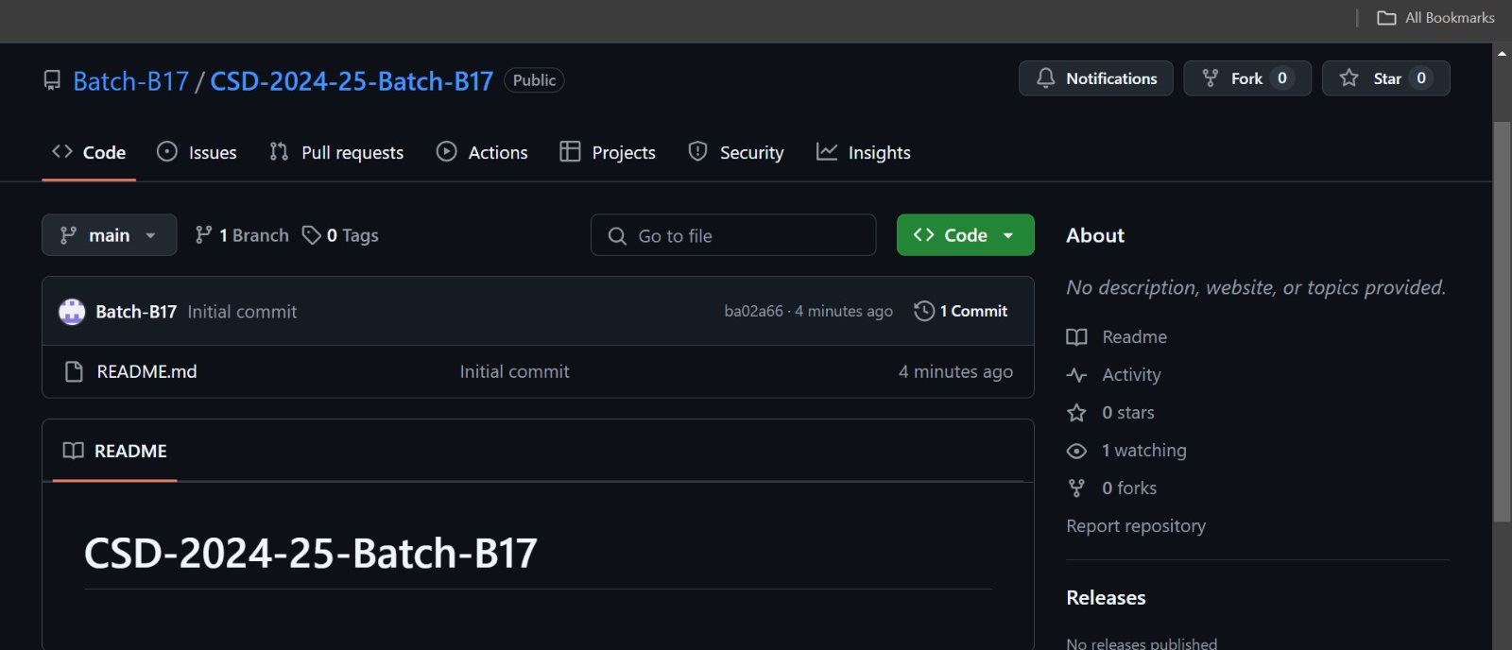

Git Hub Dashboard

Slide 28
Any Queries?

Slide 29
Thank You!!!

